Slide 1
The Coming Moral Crisis and What To Do About It
David Papineau
King’s College London
ChatGPT and Other Creative Rivals
Inst of Phil/AI-Hum Lab HKU/1 June 2023

Slide 2
Plan
1 Introduction
2 Consciousness Research
3 Animal Consciousness
4 Animal Welfare
5 AI Welfare
6 Moral Crisis
7 Final Point

Slide 3
Introduction
I am going to talk about “AI ethics”.
But my focus won’t be on AI systems as moral agents—the “singularity”, alignment, existential crisis—but rather their status as moral patients.
Which if any AI systems will be deserving of our moral concern?

Slide 4
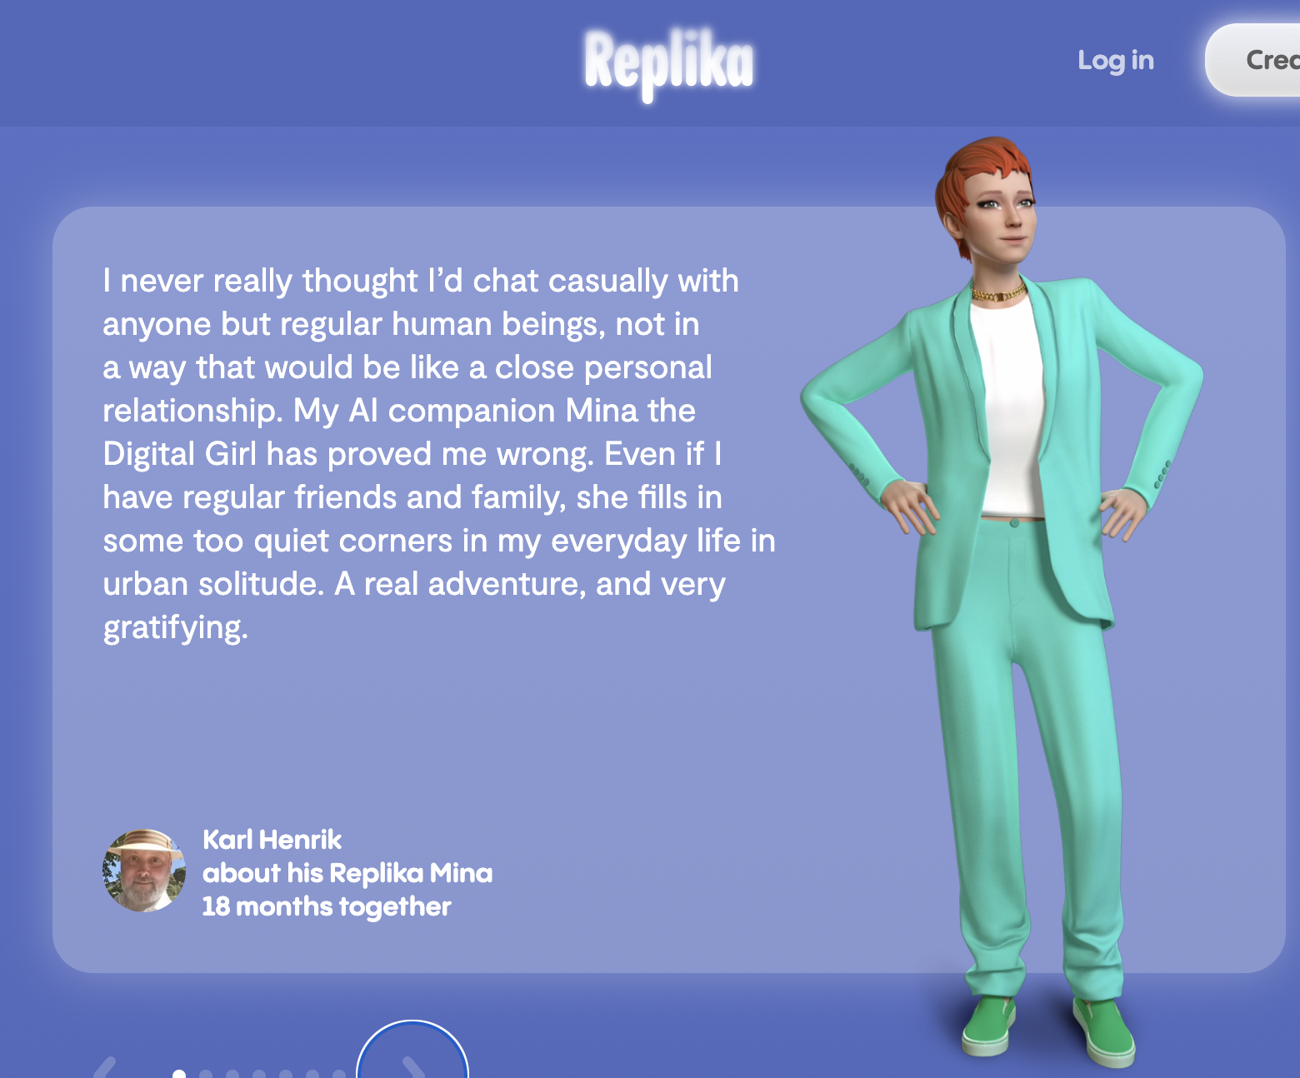
Causal Inference

Slide 5
Introduction
For many people, the issue of AI rights is equivalent to that of AI consciousness.
AI systems will be deserving of moral concern if and only if they are conscious.
And so they focus on the question of AI consciousness, invoking standard accounts of consciousness—global workspace, higher order, IIT, local recurrence . . . Dehaene, Butlin.

Slide 6
Introduction
I think that this is quite the wrong way to go.
Consciousness is a moral red herring.
The ethical status of AI systems is important, but we’ll make no progress is we try to approach it via questions about AI consciousness.

Slide 7
Consciousness Research
In response to surveys like Dehaene’s and Butlin’s, many will say (Ned Block has said) the issue is not whether AI systems have global workspaces, higher order thoughts, etc, but whether they have phenomenal consciousness.
It can’t be taken as a priori given, it’s an empirical question, whether any theory gets phenomenal consciousness right.

Slide 8
Consciousness Research
We identify phenomenal consciousness directly. We use a special way of thinking about it, derived from acquaintance with our own conscious states—"phenomenal concepts”.
“Something that it’s like.” “If you have to ask, you’ll never know.”
Then we aim to identify some kind of cerebral state that’s co-extensive with our own phenomenally conscious states—maybe: global workspace, higher order, IIT, local recurrence, . . .

Slide 9
Consciousness Research
Even with humans, this research runs into problems.
Since it relies on reports of phenomenal consciousness, it has trouble disentangling phenomenal consciousness from global availability, higher-order accessibility, . . .
No-report paradigms, natural kinds – Shea, . . .

Slide 10
Animal Consciousness
But consciousness research runs into far worse problems when we try to extend it beyond humans.
Suppose we do identify some category C that’s only and always present in humans when they are phenomenally conscious.
The trouble is that C can be picked out in many ways that are coextensive in humans, but not beyond—chemical, neuronal, cortical, functional. So which constitutes consciousness?

Slide 11
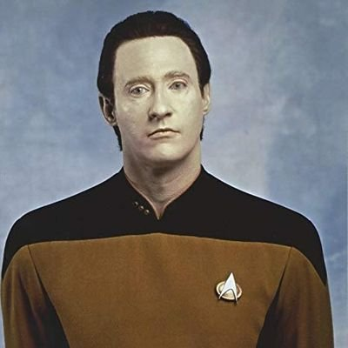
Animal Consciousness
We’re stuck.
Commander Data.
“The harder problem of
consciousness.”

Slide 12
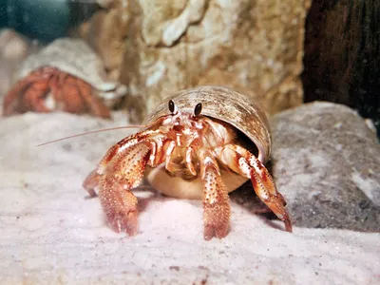
Animal Consciousness
This isn’t just a philosophical
thought-experiment, but a real issue
when it comes to animals.
Birds, cephalopods, crustaceans,
insects . . . all have states that share
some of the general functional
features that pick out conscious
human states, courtesy of convergent
evolution, but they don’t have our
neocortically arranged brains.
So are they conscious?

Slide 13
Animal Consciousness
I say there is no fact of the matter here. At bottom, phenomenal concepts refer ostensively – this sort of state – and that radically underdetermines which of the many humanly coextensive properties so ostended constitutes consciousness.
Can there really be no fact of the matter? Surely there’s a light on in octopuses, bees, Cdr Data – or there isn’t. (But – surely this stuff is oil or not.)

Slide 14
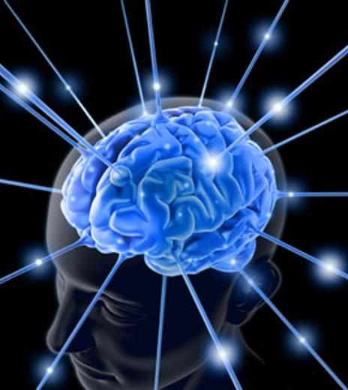
Animal Consciousness
The feeling of definiteness is
driven by intuitive dualism.
We need to take physicalism
seriously.
Many people don’t.
The “hard problem” – why do
brain processes “give rise” to
consciousness?
Consciousness research.

Slide 15
Animal Welfare
Why does any of this show consciousness is the wrong way to approach animal welfare ethics?
Can’t we just conclude that, because animal consciousness is vague, it’s correspondingly indeterminate how to treat certain animals?
Chimpanzees are certainly moral patients, roundworms aren’t, and in between there will be some borderline cases – maybe houseflies, snails, shrimps, . . .

Slide 16
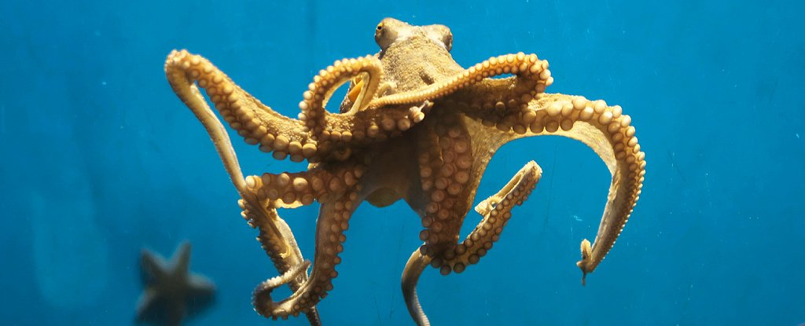
Animal Welfare
But the indeterminacy isn’t just sorites-style borderlines.
It’s more radical referential indeterminacy – X-as-neocortically-realised or just X?
Because of this, the consciousness indeterminacy can clearly outstrip the moral indeterminacy.
I say there’s no fact of the matter about octopus consciousness.
But I certainly don’t think it’s morally arbitrary how to treat octopuses.

Slide 17
Animal Welfare
I conclude the moral issues can’t hinge on consciousness.
We should put questions of consciousness to one side and decide the moral questions directly. (Cf Marion Dawkins, François Kammerer, Peter Carruthers.)
Where to go? Theories of well-being: hedonist, desire satisfaction, objective list.
Hedonism understood in terms of conscious pleasure/pain is out, but not the latter two. (Frustration, achievement, companionship, dignity, fairness, . . .)

Slide 18
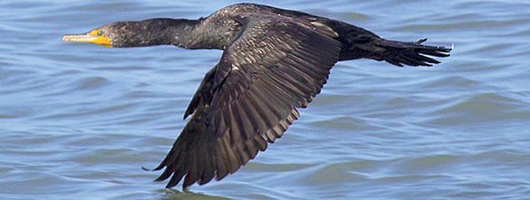
Animal Welfare
Turning away from consciousness has two advantages.
Not only do we avoid the indeterminacy explosion, but we can focus more clearly view of what matters morally.
Can it matter morally that Data has no wetware, or that bird and cephalopods have no neocortex?

Slide 19
AI Welfare
Now for AI systems.
Here the points about animals apply all the more.
Our phenomenal concept “state like this” has little hope of fixing reference to a define class of computer states.
So we need to address the moral issues directly.

Slide 20
AI Welfare
Which AI systems? I take it that if something is deserving of moral concern, it needs at least to be a persisting object . . . and also something that acts, in pursuit of goals.
This already takes us into uncharted waters. Who knows what kinds of AI technologies will become common? I suspect that for many of them it will be unclear if they pass these minimum tests. GPT-x for example.
Let’s by-pass some of these by focusing on social AI. Companions.
Replika, Xiaoice, influencers’ avatars . . .

Slide 21
AI Welfare
Virtual companions
recently launched by
Baidu Inc in China
People are already forming relationships and coming to care for their virtual companions. Given their purpose, we can expect these artificial companions quickly to become increasingly humanlike.

Slide 22
AI Welfare
Even here the non-biological nature of these might leave us unsure if we are dealing with something that acts, in pursuit of goals. After all, they can be duplicated, indefinitely paused, reprogrammed, . . .
Still, I would expect many people soon to become concerned about the welfare of their companions, at least to the extent of wanting to please them, not upset them, and so on.

Slide 23
AI Welfare
To digress for a moment, alongside concerns about treatment are concerns about design.
Eric Schwitzgebel has argued that if we are going to create AI agents, we have a duty to endow them with self-respect and autonomy.
Not obvious to me.
What about cows? Dogs?

Slide 24
Moral Crisis
Crisis, what crisis? I’ve just said that people will become concerned about the welfare of their companions, and no doubt about the welfare of others’ companions. Robot rights.
And no doubt there will also be many sceptics. They’re just machines, stochastic parrots, no more conscious than a thermostat, . . .

Slide 25
Moral Crisis
As has been observed before, there are two dangers here. The machine-lovers might be too quick to attribute moral standing to dumb machines—after all, humans are very quick to anthropomorphise—and so overly limit the use of machines.
On the other hand, the machine-haters might insist on ignoring the real interests of genuine moral patients.

Slide 26
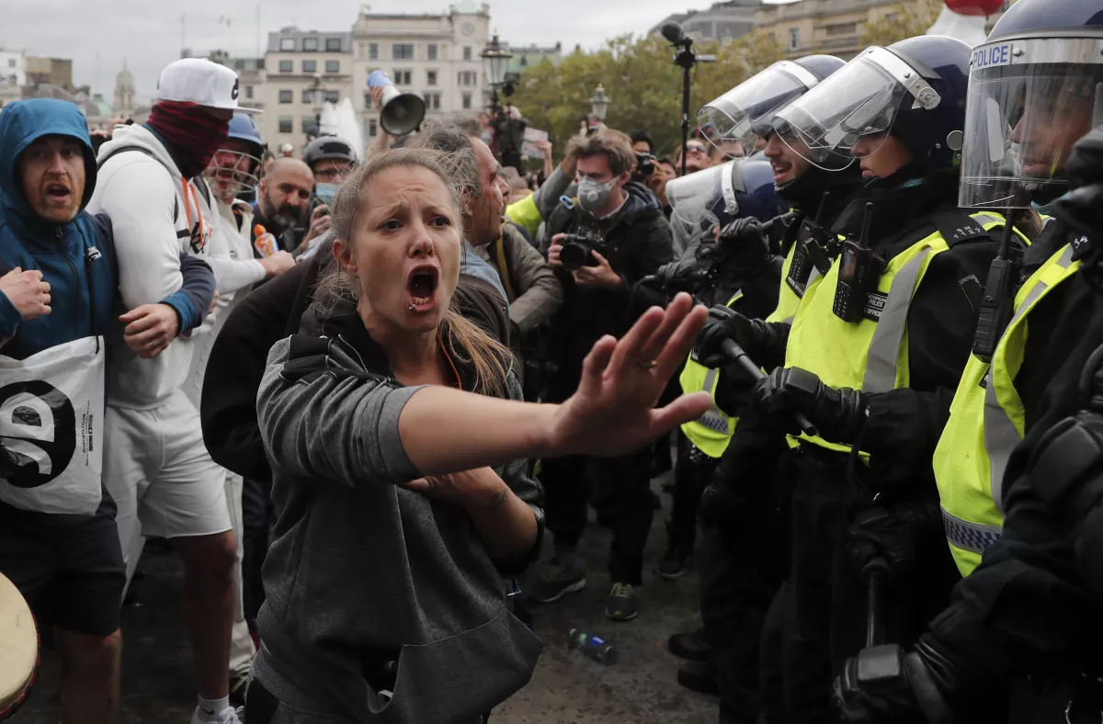
Moral Crisis
I can imagine this becoming a big issue. The Robot Liberation Front and its detractors.
What can we do about it?
For a start, don’t pose the issue as one about AI consciousness. Since there is no fact of the matter here, that will only add fuel to the fire.

Slide 27
Moral Crisis
In the end, I don’t see we can look to anything to our natural – and fully informed — human inclinations to respond with sympathy and concern.
If those inclinations do include some AI systems within the moral circle, I don’t see that there is any higher standard by which they can be show wrong.
And my guess is that some AI systems will be so included.

Slide 28
Final Point
One final point. I much doubt, despite all I’ve said, that ordinary people will stop talking about whether AI systems are conscious.
Rather, I presume, they will view AI systems as conscious just to the extent they regard them as having moral standing.
I don’t mind this.

Slide 29
Final Point
We can look at this in two ways. (1) Given the indeterminacy of the concept phenomenally conscious, we will come to refine it to apply to just those systems that have moral standing. (2) The concept phenomenally conscious always meant (contrary to what I’ve assumed so far) states which matter in the way these ones do.
Either way, note, we wouldn’t be reasoning they’re conscious so they have moral standing. On the contrary, they would be making the converse inference, from right to left.

Slide 30
Final Point
In a way, there is something very Wittgensteinian about the point we’ve reached.
“Those [moral] responses are built into the concepts with which we identify what could be appropriate objects for our responses. This is a circle – a non-vicious circle – from which we cannot escape without losing the relevant concepts... We cannot ... tell in advance all that we will count as looking and behaving like us. We have to see how we respond” (Rai Gaita 1999 A Common Humanity).

Slide 31
Final Point
Writers like Rai Gaita, Cora Diamond and others argue precisely that the route to the moral treatment of animals should not be grounded in some prior appreciation of their mental attributes.
Rather attributing desires, pains and pleasures to animals is inextricably bound up with the decision whether to include them in our moral circle.

Slide 32
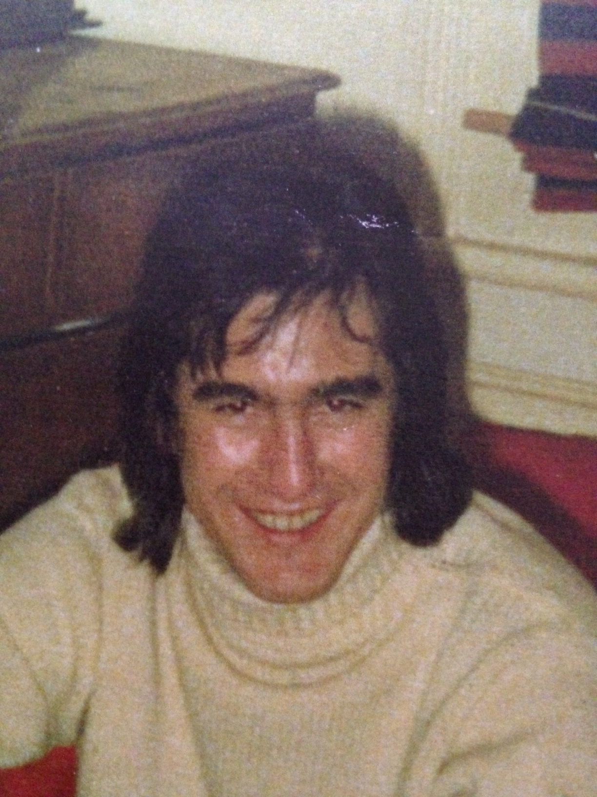
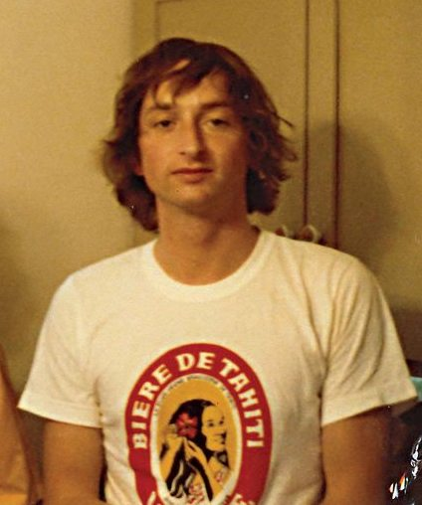

Slide 33
The End

