Slide 1
Healthy, Harmful, Proximal Dysfunctions
David Papineau
King’s College London
Function & Dysfunction in Medicine & Psychiatry
Sowerby-Templeton Workshop
King’s College London
January 20-21 2024

Slide 2
Plan
Introduction
Neander on Malfunction
Neander of Misrepresentation
Proximal Effects, Distal Contents
Proximal Mismatches
Intrinsic Disorders
Environmental Disorders?
Final Thoughts

Slide 3
Introduction
Let’s take it that:
(a) functions are aetiological
(b) dysfunctions are necessary for disease
Perhaps these deserve further discussion, but let’s keep things simple for now. (Actually, I’ll come back to the second at the end.)

Slide 4
Introduction
Dysfunctions might be necessary for disease, but are they sufficient? Some (Boorse) say yes, but most say we need to add an extra negativity requirement—harm for Wakefield, knock-on dysfunctions for Fagerberg.
I’m going to argue that we need to add a yet further requirement. Something needs to have gone awry internally. You can’t have a disease if you are intrinsically identical to someone who is healthy.

Slide 5
Introduction
The rationale for adding this is that some dysfunctions aren’t due to anything not working internally, but purely to unfriendly environments. We don’t want to count cases like these as disorders.
Fagerberg and Garson argue that this issue can be dealt with by restricting dysfunctions to failures of proximal function. In their view, unfriendly environments only disrupt distal “functions” (beneficial effects) not proximal ones. But I’ll show this doesn’t work.

Slide 6
Introduction
I agree entirely with Fagerberg and Garson that it is better not to medicalise complaints that are constituted solely by unfriendly environments. But the way to avoid this is to add an explicit requirement of internal breakdown. Focusing on proximal functions won’t do it.
So that’s the idea—you can have a harmful, proximal dysfunction, and yet still be healthy—because the dysfunction is just a matter of an unfavourable environment.

Slide 7
Neander on Malfunction
Once upon a time, we aetiologists about functions really didn’t like Robert Cummins’ analysis of functions. (Functions explain but Cummins-functions don’t.)
But then Karen Neander’s “Malfunctioning and Misrepresenting” showed us that Cummins had much to offer us.
Mal(dys)function of X means specifically lack of the most proximal designed effect of X, at the level of Cummins-decomposition where it first comes into view.

Slide 8
Neander on Misrepresentation
But Neander went wrong when she moved from malfunction to misrepresentation.
Is a visual system malfunctioning when it’s fooled by deceptive circumstances (a Necker cube, a moving black dot)? Orthodox teleosemantics suggests “yes”. But Neander demurred, as would many. (There’s nothing wrong with those visual systems.)

Slide 9
Neander on Misrepresentation
So Neander needed some proximal function that is served in illusory cases. She came up with detecting the stimulus condition. (The system detects the flying bugs/cubes by first detecting moving black dot/2-d array of lines.)
To my mind, this throws away all the advantages of teleosemantics. In particular it makes misrepresentation much too hard.

Slide 10
Proximal Effects, Distal Contents
Better to stick with the idea that the system’s function is to represent external conditions—and grasp the nettle that unfriendly environments can per se generate malfunctions.
Fagerberg and Garson think that this means giving up the tie between malfunction and proximal effects.
Not at all.

Slide 11
Proximal Effects, Distal Contents
Neander is right that the visual system is malfunctioning only if it fails to produce its most proximal designed effect, and what’s more she is right that this is a response function, to produce that effect in response to a certain condition, which condition is then its content.
But all of this leaves open what that condition is. Neander’s predilection for local stimulus conditions is unmotivated and unfocused.

Slide 12
Proximal Effects, Distal Contents
To pick out the condition the system’s been designed to respond to, we need to look downstream, to the consumer of the representation (the tongue snapper, the human motor system) and note the conditions for its success (flying bugs, 3-d cubes).
It is tempting to think that, when we decompose representational systems into their parts, Cummins-style, and try to pick out the proximal functions of the parts, everything is going now going to be intrinsic to the system—after all, we’re looking at functions of internal parts interacting with other internal parts

Slide 13
Proximal Effects, Distal Contents
But this is a fallacy when it comes to representation. The function of the representing parts can still be to guide consumers in a way that will succeed if certain external circumstances obtain.

Slide 14
Proximal Mismatches
So we can have proximal malfunctions due to environmental mismatch. Visual illusions, for example.
Perhaps this should have been obvious from the start. Cummins-style decompositions can be more or less fine-grained (left atrium, heart, cardiovascular system, . . .). When we get to whole-body systems, there can be nowhere else to go for proximal effects than then environment.
What’s the function of camouflage except to hide against the background, of foraging systems except to find food, of our sensory-motor system except to grasp objects,. . . ?

Slide 15
Intrinsic Disorders
Let’s go back to the idea that nothing is wrong with you—wrong with you—if malfunctions are constituted by environmental mismatch.
I have argued that we can’t preserve this idea by saying only proximal malfunctions count as disorders. Some proximal malfunctions are themselves constituted by environmental mismatch.

Slide 16
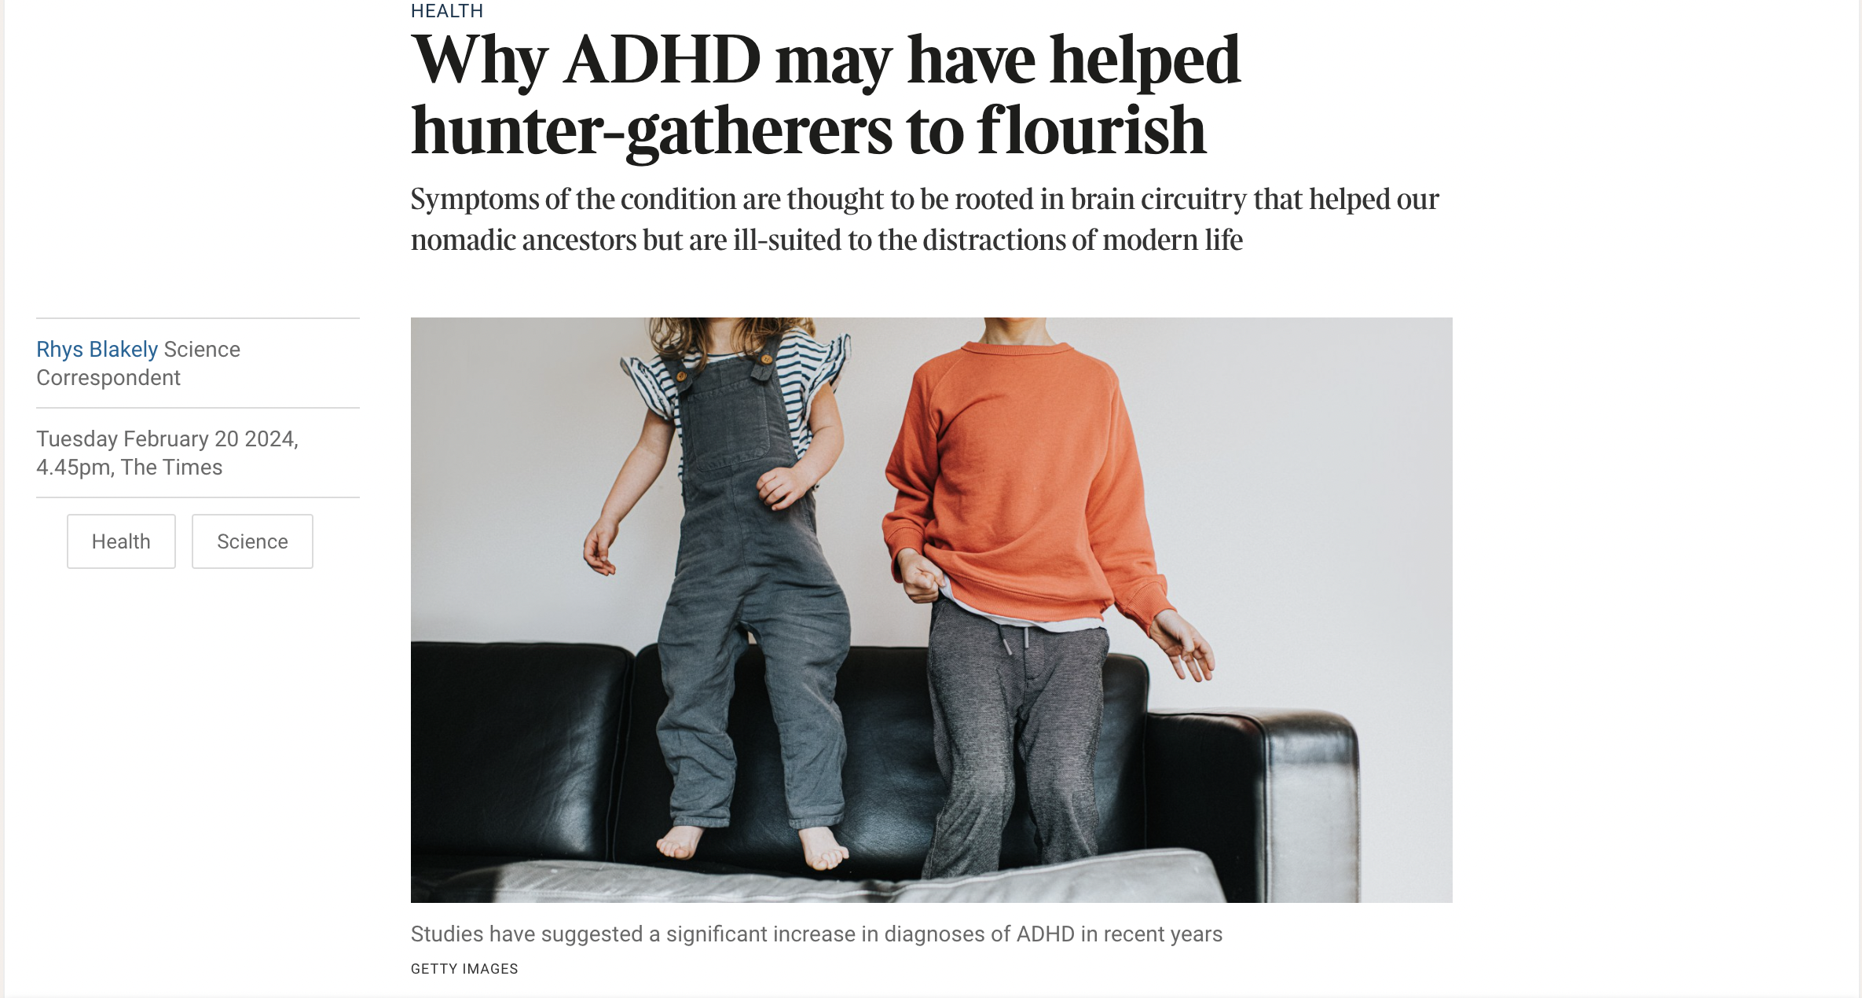
Intrinsic Disorders
So I say we should preserve the idea by saying disorders require specifically malfunctions that involve something internal not working as designed. Ailments constituted by unfriendly environments aren’t disorders—perhaps including ADHD, depression (pace James Turner yesterday), anxiety disorders, some forms of sociopathy.

Slide 17
Environmental Disorders?
Are things that straightforward?
Fabian Hundermark observed yesterday that DSM is happy to count some of these mismatch cases as diseases.
We can see why. If the unfriendly environments are widespread, then some people will be suffering, whether or not we deem them to be unhealthy. What should be done?
Adjust society? Or adjust them? We might well go different ways in different cases. And it makes a kind of sense to say we have disorders in just those cases where we deem it best to adjust the sufferers not their environments.

Slide 18
Environmental Disorders?
It might make a kind of sense, but is it right?
What to adjust is a political-moral issue. We don’t have to be relativists to recognise that these are matters on which reasonable people, with different priorities, might well disagree. Do we want to category of disease to rest on such political-moral foundations?
After all, if we went that way, why bother with biological dysfunction at all? Just count as disorders any harms that are politically deemed to call for treatment of individuals—dyslexia, deviations from current standards of beauty, . . .)

Slide 19
Environmental Disorders?
It might make a kind of sense, but is it right?
What to adjust is a political-moral issue. We don’t have to be relativists to recognise that these are matters on which reasonable people, with different priorities, might well disagree. Do we want to category of disease to rest on such political-moral foundations?
After all, if we went that way, why bother with biological dysfunction at all? Why not just count as disorders any harms that call for treatment of individuals—dyslexia, deviations from current standards of beauty, . . ?

Slide 20
Final Thoughts
So I’m inclined to stick with requiring some internal biological breakdown for disease. Environmental mismatch does not suffice for disorder. We can tell ADHDs, depressives, sociopaths they aren’t ill. They’re just unlucky. In another time, they would have been untroubled members of society.
Am I not arguing that, for political-moral reasons, it is better to keep disease tied to objective biological categories?
Sure. I don’t see anything wrong with that.

Slide 21
The End

